Slide 1
Outline:
5.1 INTRODUCTION
5.2 NOTATION FOR TIME-VARYING POSITION AND ORIENTATION
5.3 LINEAR AND ROTATIONAL VELOCITY OF RIGID BODIES
5.4 MOTION OF THE LINKS OF A ROBOT
5. 5 VELOCITY "PROPAGATION" FROM LINK TO LINK
5.6 JACOBIANS
5.7 SINGULARITIES
5.8 STATIC FORCES IN MANIPULATORS
5.9 JACOBIANS IN THE FORCE DOMAIN

Slide 2
Introduction
In this Chapter the following concepts will be studied:
The linear and angular velocity of a rigid body to analyze the motion of the manipulator
Forces that act on a rigid body (application on static forces of a manipulator)
➔ Jacobian matrix relations

Slide 3
Introduction
Velocity analysis between Cartesian Space and Joint Space
Jacobian Matrix
Transformation/Mapping
If J is singular
it is not invertible
Singular point/configuration
(Important issue in robot design
that should be avoided)
When θ₂ = 0/180 ➔
singular configuration
The Jacobian is important to determine the torque in the joints needed to be
applied to give a specific contact force at the End-Effector (Static problem)

Slide 4
Notations
Differentiation of a position vector (Linear Velocity)
≡ the velocity of a position vector
≡ Linear velocity of a point in space represented by the position vector.
Derivative is made relative to frame {B} (Frame of Differentiation)
Also the velocity vector is expressed in the same frame {B}
To express the velocity in any other frame {A}
≡ The velocity of point (position vector Q) relative the frame {B} expressed in frame {A}.
(draw frames for explanations)

Slide 5
Notations
Differentiation of a position vector (Linear Velocity)
Often used the velocity of the origin of a frame {C} (for example) relative to the universe frame {U}.
Remember that in the differentiation is made relative to {U} and expressed in {U}
as v is small-letter the differentiation is made relative/ respect to {U}, but the velocity is expressed in {A}.
Example:

Slide 6
Notations
Example 5.1:

Slide 7
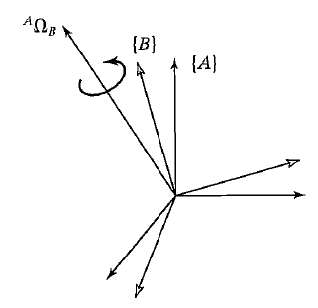
Notations
The Angular Velocity Vector
Angular velocity vector of a body ( is for a point)
As a frame represents the orientation
of the body ≡ rotational velocity of the
frame.
Rotational velocity of frame {B} relative
to frame {A}:
- it’s direction represents the instantaneous
axis of rotation of {B} relative to {A}
- it’s magnitude represents the speed of rotation.
the angular velocity of {B} relative to {A} expressed in {C}
In the universe frame {U}

Slide 8
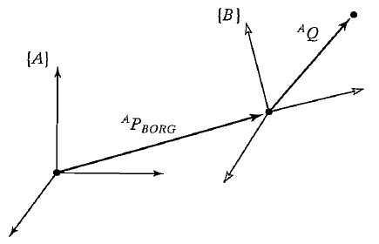
Linear and rotational velocities of rigid bodies
Linear velocity: (Translation only)
Translation only ➔ the orientation of {B} relative to {A} is not changing

Slide 9
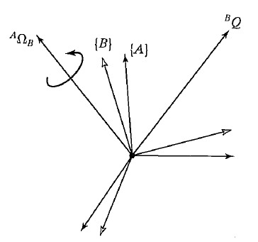
Linear and rotational velocities of rigid bodies
Rotational velocity: (Rotation only)
Two frames {A} and {B} have the same origin for all the time only the relative orientation is changing in time ➔
is fixed in {B} ➔
What is the velocity of point Q in {A}
If is changing in {B}

Slide 10
Linear and rotational velocities of rigid bodies
Linear and rotational velocity at the same time
The same as point 2, however frame {B} is moving relative to frame {A}, i.e.

Slide 11
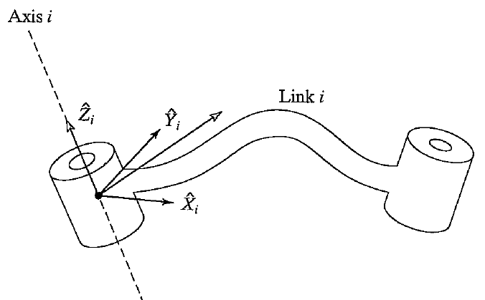
Motion of the links of a robot (notations)
≡ linear velocity of the origin of frame {i} relative to the reference frame {O} (fixed), expressed in {i}
≡ angular velocity of frame {i} relative to the reference frame {O} (fixed), expressed in {i}

Slide 12
Velocity propagation from link to link
Starting from the base the velocity of any link
(i+1) equal to the previous link (i) + the relative
Velocity between (i+1) and (i)
Angular velocity propagation
Note that: is the third column of

Slide 13
Velocity propagation from link to link
Linear velocity propagation
A ≡ 0; Q ≡ i+1; B ≡ i;

Slide 14
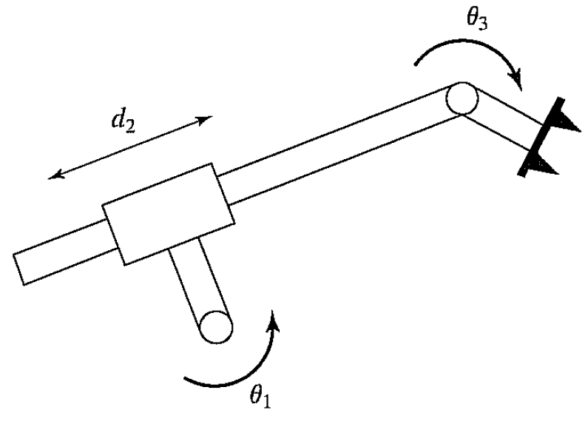
Velocity propagation from link to link
Prismatic joint
A ≡ 0; Q ≡ i+1; B ≡ i;
≠ 0

Slide 15
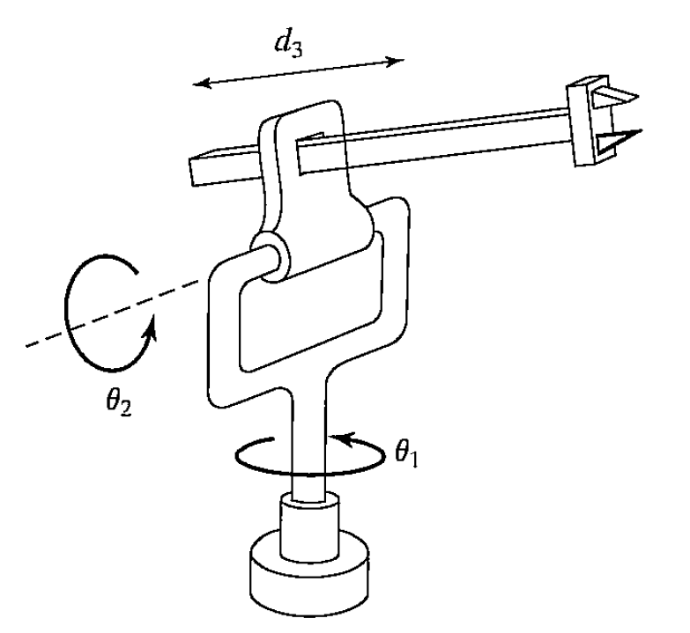
Velocity propagation from link to link
Example
three

Slide 16
Velocity propagation from link to link
Example (Solution)
From the following can be extracted:
i | a_{i-1} | α_{i-1} | θ_{i} | d_{i}
1 | 0 | 0 | θ₁ | 0
2 | 0 | 90 | θ₂ | 0
3 | a₂= Const. | 90 | 0 | d₃

Slide 17
Velocity propagation from link to link
Example (Solution)

Slide 18
Velocity propagation from link to link
Example (Solution)
Expressed in {0} frame
End of the solution

Slide 19
Velocity propagation from link to link
Example (Solution)
One can put in the following form

Slide 20
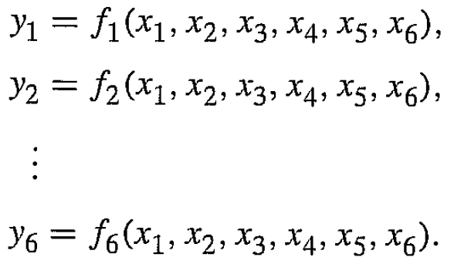
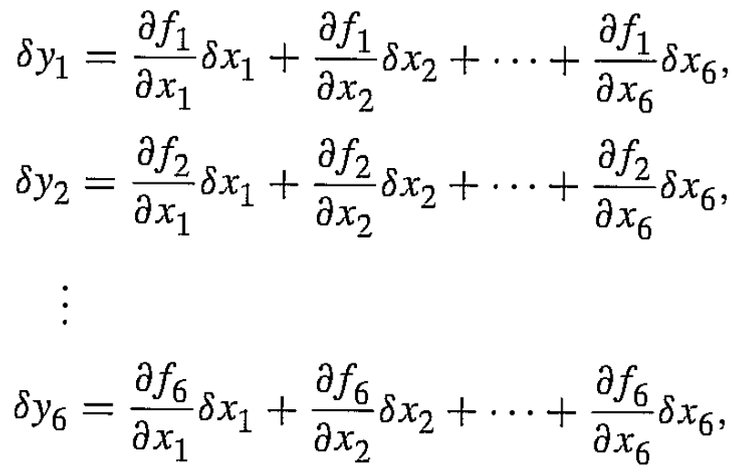
Jacobians
If we have the function:
Or, in vector form
The differentiation of y_{i} can be considered as follows:

Slide 21
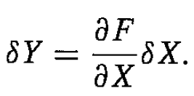
Jacobians
Or, simply, in matrix form
Remark: for nonlinear functions f₁, f₂, …, f_{n} of X the partial derivative is also a function of X
Jacobian maps/transform velocities from X to Y
As X=X(t) (time dependent) ➔J=J(X) is also time dependent.

Slide 22
Jacobians
In robotics, the Jacobian relates the Cartesian velocities with joint velocities
≡ vector of joint angles
≡ vector of joint velocities
General Case:
Instantaneous, as Θ is changing ➔ J(Θ ) is changing
# of columns
= # of DoF

Slide 23
Jacobians
For the previous equation find
See the example
of the book

Slide 24
Singularities
Given , find
is invertible if
For some values of , could be non-invertible
➔ singularities of the robot
Singularity:
Boundary singularity:
Interior singularity

Slide 25
Singularities
Boundary singularity:
All robots have singularities at the boundary or their workspace.

Slide 26
Singularities
Interior singularity
Inside the workspace, away from the WS boundary.
Generally are caused by a lining up of two or more joint axes.
When a manipulator is in a singular configuration, it has lost one or more degrees of freedom!

Slide 27
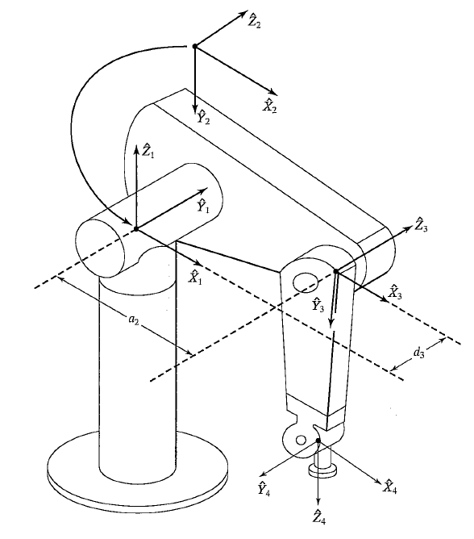
Singularities
Example: the Puma robot
has two singular
configurations (not only)
θ₃ ≅ -90° (Boundary)
θ₅ ≅ 0° (Interior)

Slide 28
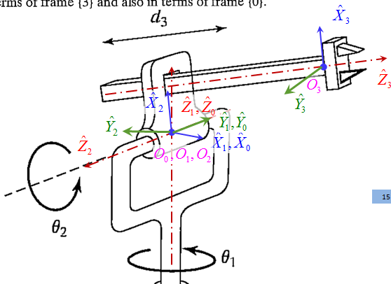
Singularities
Example: determine the
singular configurations
for the robot of the
previous example basing
on its Jacobian that
relates
Solution

Slide 29
Singularities
See example 5.4 of the book

Slide 30
Singularities
For the previous example if
If we try to calculate
at singular configuration
this value tends to ∞

Slide 31
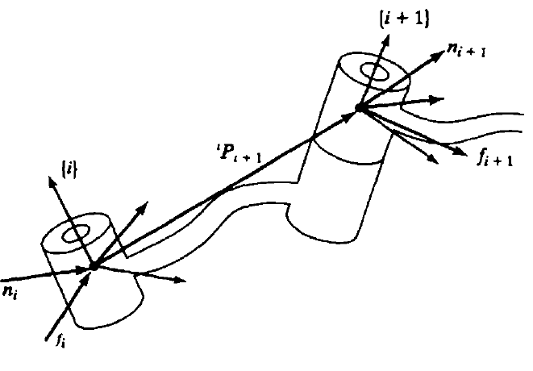
FORCES IN MANIPULATORS
Discuss the concept of force and moment propagation
Starting from the last link to the base
Force (equilibrium)
Use the notation:
${\vec{f}}_{i,i+1}$ ≡ force exerted by link i on link i+1
${\vec{f}}_{i+1,i}$ = ${−\vec{f}}_{i,i+1}$
regardless to the frame of notation
all vectors must be expressed in the
same frame.
$\sum{\vec{F}=0}$
➔ ${{\vec{f}}_{i−1,i}+\vec{f}}_{i+1,i}=0$ ➔ ${{\vec{f}}_{i−1,i}=−\vec{f}}_{i+1,i}$
Different notation
is used here

Slide 32
FORCES IN MANIPULATORS
Moment equation (equilibrium)
Use the notation:
${\vec{n}}_{i,i+1}$ ≡ Moment exerted by link i on link i+1
${\vec{n}}_{i+1,i}$ = ${−\vec{n}}_{i,i+1}$
$\sum{{\vec{M}}_{Oi}=0}$
➔ ${{\vec{n}}_{i−1,i}+\vec{n}}_{i+1,i}+{\vec{P}}_{i+1,i}×{\vec{f}}_{i+1,i}=0$
➔ ${{\vec{n}}_{i−1,i}=−\vec{n}}_{i+1,i}−{\vec{P}}_{i+1,i}×{\vec{f}}_{i+1,i}=0$
Different notation
is used here

Slide 33
FORCES IN MANIPULATORS
Relation between joint [torque (motor torque) for revolute joint, or joint actuating force (linear actuator force)] and joint reactions:
Joint i is revolute
The structure of the joint hold the force ${\vec{f}}_{i−1,i}$ does not affect joint torque
Only the component of ${\vec{n}}_{i−1,i}$ in the direction of ${\vec{z}}_{i}$ affect joint torque, i.e.:
$τ_{i}={\left({\vec{n}}_{i−1,i}\right)}^{T}∙{\vec{z}}_{i}$

Slide 34
FORCES IN MANIPULATORS
Relation between joint [torque (motor torque) for revolute joint, or joint actuating force (linear actuator force)] and joint reactions:
Joint i is prismatic
The structure of the joint holds the moment, ${\vec{n}}_{i−1,i}$ does not affect joint force
Only the component of ${\vec{f}}_{i−1,i}$ in the direction of ${\vec{z}}_{i}$ affect joint force, i.e.:
$τ_{i}={\left({\vec{f}}_{i−1,i}\right)}^{T}∙{\vec{z}}_{i}$
Principle of Virtual Work!

Slide 35
FORCES IN MANIPULATORS
Example: if a force of${}^{3}\vec{F}$ acts at the O₃, find joint torques and forces
Solve it!
$${}^{3}\vec{F}$$

Slide 36
FORCES IN MANIPULATORS
Recall:

Slide 37
FORCES IN MANIPULATORS
Recall:
on O₃
For the same point
of O₃

Slide 38
FORCES IN MANIPULATORS
Recall:
on body 3
For the same point
Of body 3

